Slide 1
8- Scope

Slide 2
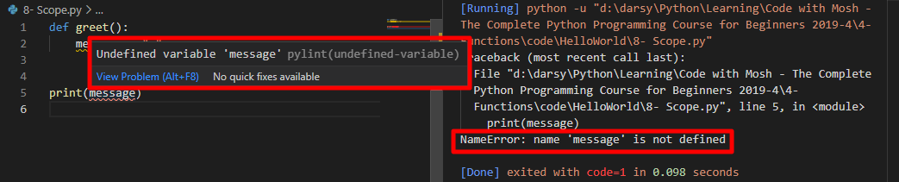
In programming We have a very important concept called scope which refers to the region of the code where a variable is defined
The scope of this variable is the greet function

Slide 3

The same rule applies to the parameters of our functions.
The scope of the name and message variables are the greet function and we refer to these variables as local variables in this function
Their local in this function which means they don’t exist anywhere else

Slide 4
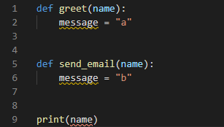
And that means we can have another function. Let's say send email with a parameter with the same name. Here we can have a message variable. But this message variable is completely different from the message variable we have in the greet function.
And of course the same rule applies to the name parameters in these functions. they are completely separate.

Slide 5
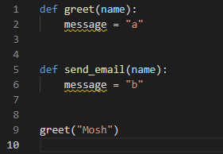
These local variables have a short lifetime.
Python interpreter will allocate some memory and have the name and message variables reference those memory locations.
when we finish executing the greet function because these variables are not referenced or used anywhere else eventually they get garbage collected, which means Python Interpreter will release the memory that allocated for these variables.

Slide 6
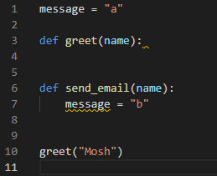
Global variables
In contrast to local variables, we have global variables.
Message is global variable which means it’s accessible anywhere in this file, So the scope of this variable is this file. We can use it anywhere in this file in any functions or outside of a function.
Now for this reason, global variables stay in memory for a longer period of time until they are garbage collected
And you should not use them that often.
In fact global variables are really evil.
so as a best practice create functions with parameters and local variables.

Slide 7
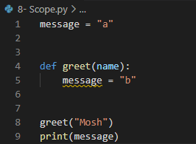
by default Python interpreter treats this message variable as a local variable at the greet function, even though it has the same name as the global variable that we have on line one. So these two variables are separate.

Slide 8
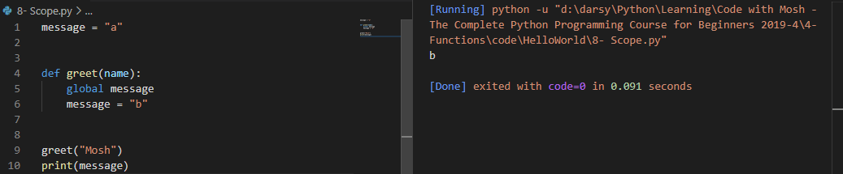
Bad practice:
modify the value of this global message variable inside of a function.
you should avoid it at all times.
When Python interpreter sees this line it will realize that in this function we want to use the global message variable so it will not define a local variable in this function.

Slide 9
Why is this bad? Because it is possible that you might have multiple functions that rely on the value of this global variable. If you accidentally or deliberately change the value of this global variable in one function this might have a side effect in other functions. Those functions may not behave properly. and this way we can create a bug in our program.
So global variables have always been bad. This is not a python thing. This is a discussion that's been going on for decades. Avoid them as much as you can. or if there are situations that you really need to define a variable globally in a file that's okay. But o not modify it in a function as you see here.

